Slide 1


SOLAR ENERGY
PRODUCTION
CLUSTERING
ANALYSIS
DATA-DRIVEN IDENTIFICATION OF HIGH-POTENTIAL SOLAR ZONES
AADITYA NANDWANA
01

Slide 2


PROJECT OVERVIEW
This analysis leverages machine learning clustering techniques to examine solar project data across regions. By identifying patterns in energy production, we can classify areas into high, medium, and low production zones, enabling data-driven business decisions and strategic resource allocation.
Our goal is to transform raw solar data into actionable insights that guide investment priorities and optimize solar deployment strategies.
02

Slide 3

PROBLEM STATEMENT
The solar energy industry faces critical challenges: lack of clear regional solar insights, difficulty identifying high-potential areas for development, and the need for data-driven decision making to guide strategic investments.
03

Slide 4



OBJECTIVES
Cluster Regions: Group geographic areas based on solar energy production levels using machine learning clustering algorithms.
Identify Production Zones: Classify regions into high, medium, and low production zones to reveal patterns in solar adoption and output.
Support Business Strategy: Provide actionable insights to guide resource allocation, investment decisions, and strategic planning.
04

Slide 5



DATASET DESCRIPTION
Our analysis utilizes comprehensive solar project data containing key identifiers including ZIP code, city, and county. Core metrics include energy production measured in kWh, PV system size specifications, and the total number of solar projects per region.
05

Slide 6



DATA
PREPROCESSING
Data Cleaning: Systematic removal of errors, duplicates, and outliers to ensure data quality and reliability for accurate clustering analysis.
Missing Values: Appropriate handling of incomplete records through imputation or removal to maintain dataset integrity.
Standardization: Normalization of variables to uniform scale ensuring all features contribute equally to clustering algorithms.
06

Slide 7



FEATURE
ENGINEERING
Total Energy Production: Aggregated kWh output calculated for each geographic region to identify overall production capacity.
Average Energy Per Project: Mean energy output computed per solar installation to normalize for project count variations.
Energy Density Metrics: Production intensity ratios derived to measure efficiency relative to system size and regional factors.
07

Slide 8

DATA AGGREGATION
Data was grouped by ZIP code to calculate totals and averages for key metrics, enabling regional analysis of solar energy production patterns.
ZIP CODES
AVG KWH
156
42K
08

Slide 9



MACHINE LEARNING APPROACH
Three clustering algorithms were applied to identify solar production zones: K-Means clustering for partitioning data into distinct groups, Agglomerative hierarchical clustering for building nested cluster structures, and Gaussian Mixture Models for probabilistic cluster assignment.
09

Slide 10


MODEL EVALUATION
Metrics used to assess clustering quality and validate the effectiveness of our solar zone identification approach.
SILHOUETTE
DAVIES-BOULDIN
0.72
0.45
10

Slide 11
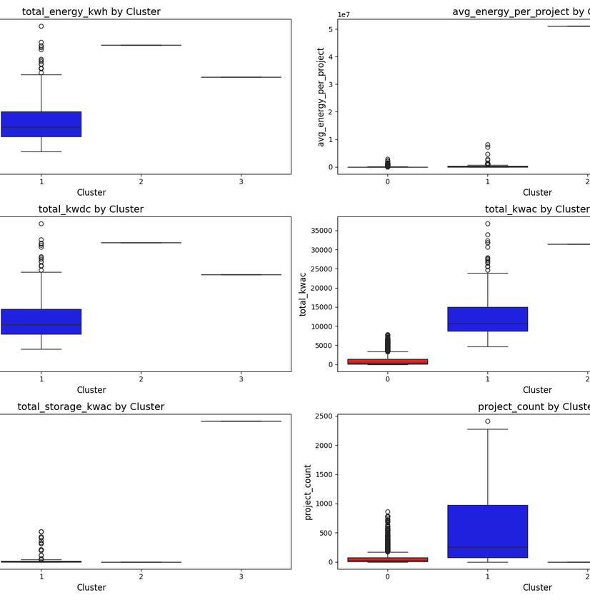
CLUSTERING RESULTS
Our analysis revealed clear distinct clusters identifying high, medium, and low solar production zones. The boxplot visualizations demonstrate significant separation between cluster groups across key metrics including total energy production, average output per project, and energy density.
11

Slide 12
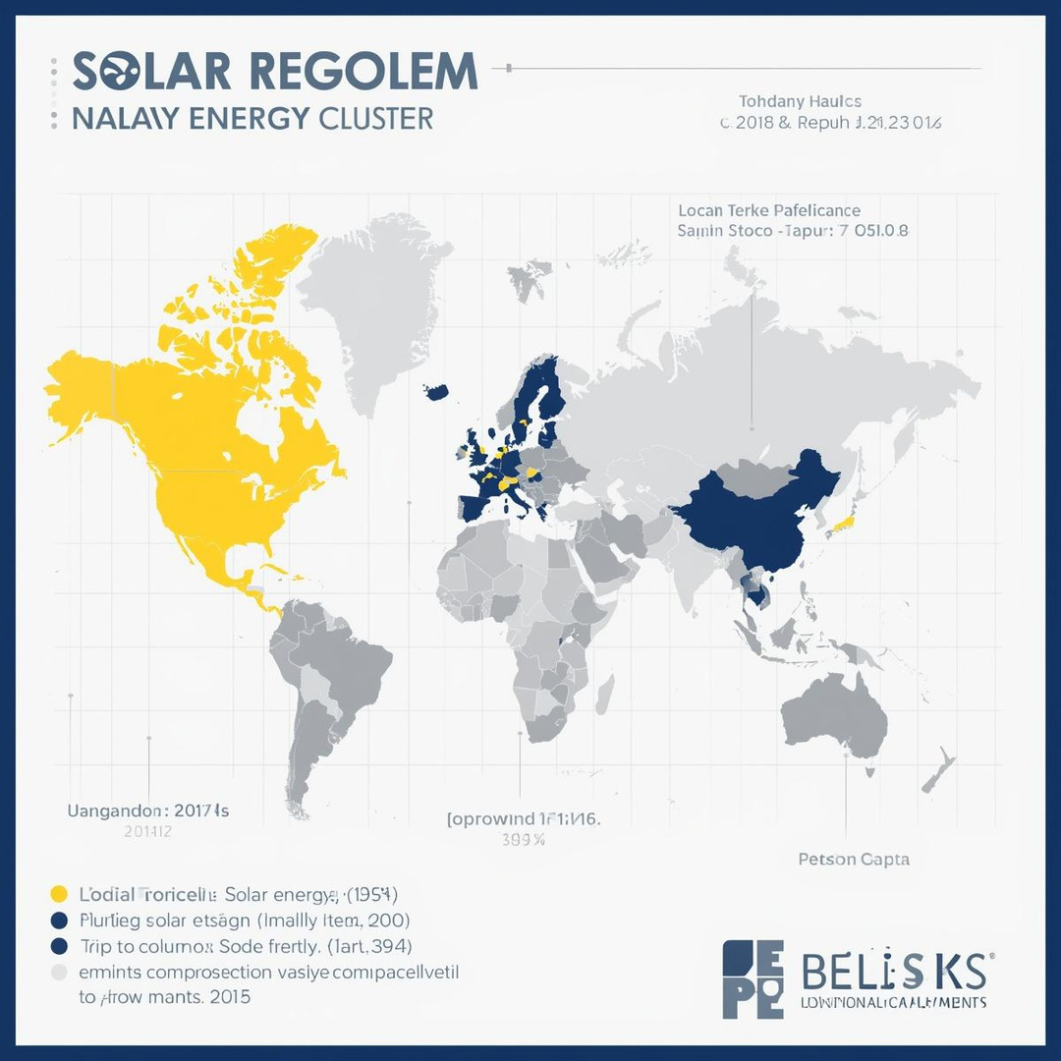
MAP VISUALIZATION
Interactive map concept showing cluster zones color-coded by production level: high production zones in yellow, medium zones in blue, and low production zones in gray for clear geographic insights.
12

Slide 13



KEY INSIGHTS
High Production Zones: Analysis reveals clearly defined high-output solar regions with optimal conditions for energy generation and investment.
Low Production Zones: These areas demonstrate lower solar adoption rates and reduced energy output, requiring targeted intervention strategies.
Medium Production Zones: Identified as key growth opportunities with potential for expansion through strategic resource allocation.
13

Slide 14



BUSINESS IMPACT
The clustering analysis delivers significant business value by enabling better targeting of marketing and sales efforts toward high-potential solar zones. It supports efficient allocation of resources and improves strategic planning for solar project rollout.
14

Slide 15

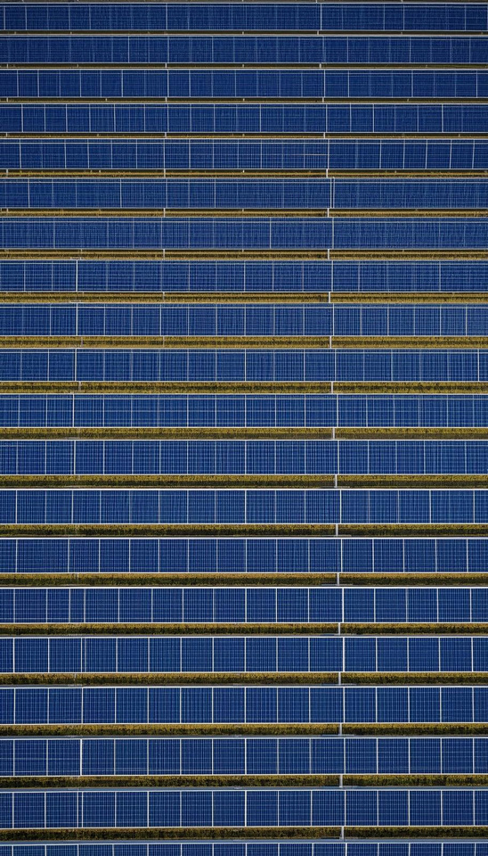

RECOMMENDATIONS
Focus on High Production Zones: Prioritize investments and resources in regions identified as high-production clusters for maximum ROI.
Expand in Medium Zones: Target medium-production areas for growth initiatives, marketing campaigns, and infrastructure development.
Analyze Before Low Zone Investment: Conduct deeper analysis of low-production zones before committing resources to understand barriers.
15

Slide 16


LIMITATIONS
While our clustering analysis provides valuable insights, certain constraints should be acknowledged. The dataset is limited to available solar project records, which may not capture all installations in each region. Additionally, the absence of weather patterns, climate data, and policy variables limits the contextual depth of our analysis.
These limitations may impact clustering accuracy and should be considered when making strategic decisions based on our findings.
16

Slide 17



FUTURE
SCOPE
Weather Integration: Incorporate weather and climate data to enhance clustering accuracy and provide environmental context for solar production patterns.
Interactive Dashboard: Develop a real-time interactive dashboard enabling stakeholders to explore cluster insights and monitor solar zone performance dynamically.
Advanced ML Models: Explore sophisticated machine learning algorithms such as DBSCAN and deep learning approaches for improved clustering precision.
17

Slide 18

In conclusion, our clustering analysis successfully identified distinct high, medium, and low solar production zones. These data-driven insights enable strategic resource allocation and informed business decisions for solar energy investments.
18

Slide 19

THANK YOU
QUESTIONS?
19

